Slide 1

SQL Server Administration & Azure Data Engineering
Day 1

Slide 2

Agenda
SQL Server Platform Overview
SQL Server Deployment Options
SQL Database Engine
SQL Server Platform Architecture Deep Dive
Database Design with SQL Server
SQL Server Configuration Manager
Walkthrough on Azure SQL
SQL Server & Azure SQL

Slide 3
SQL Server Platform Overview
Microsoft SQL Server is a relational database management system (RDBMS). Applications and tools connect to a SQL Server instance or database and communicate using Transact-SQL (T-SQL).
The Microsoft SQL Database Engine is the core service for storing, processing, and securing data. It provides controlled access and rapid transaction processing for a wide variety of commercial and entrepreneurial applications.
The SQL Database Engine is a multimodal database engine with purpose-built storage formats, purpose-built index structures, and a single query optimizer that makes cost-based decisions across all data models.

Slide 4
SQL Database Engine Capabilities
SQL Server comes with the following capabilities including HA/DR.
ColumnStore Indexes
Key-Value Pair
JSON Data in SQL Server
Spatial Data
Vector Search & Vector Indexes in SQL Server Engine
XML Data in SQL Server

Slide 5
SQL Server ColumnStore Indexes
A columnstore index is a technology for storing, retrieving, and managing data by using a columnar data format, called a columnstore.
Columnstore indexes are the standard for storing and querying large data warehousing fact tables. This index uses column-based data storage and query processing to achieve gains up to 10 times the query performance in your data warehouse over traditional row-oriented storage. You can also achieve gains up to 10 times the data compression.
Columnstore
A columnstore is data that's logically organized as a table with rows and columns and physically stored in a column-wise data format.
Rowstore
A rowstore is data that's logically organized as a table with rows and columns and physically stored in a row-wise data format. This format is the traditional way to store relational table data. In SQL Server, rowstore refers to a table where the underlying data storage format is a heap, a clustered index, or a memory-optimized table.

Slide 6
SQL Server Column Store Indexes
RowGroup
A rowgroup is a group of rows that are compressed into columnstore format at the same time. A rowgroup usually contains the maximum number of rows per rowgroup, which is 1,048,576 rows.
For high performance and high compression rates, the columnstore index slices the table into rowgroups, and then compresses each rowgroup in a column-wise manner. The number of rows in the rowgroup must be large enough to improve compression rates, and small enough to benefit from in-memory operations.
Column Segment
A column segment is a column of data from within the rowgroup.
Each rowgroup contains one column segment for every column in the table.
Each column segment is compressed together and stored on physical media.
There's metadata with each segment to allow for fast elimination of segments without reading them.

Slide 7
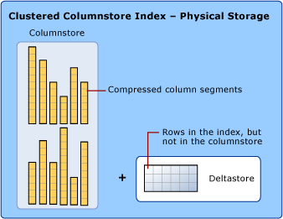
Clustered ColumnStore Index
A clustered columnstore index is the physical storage for the entire table.
To reduce fragmentation of the column segments and improve performance, the columnstore index might store some data temporarily into a clustered index called a deltastore and a B-tree list of IDs for deleted rows.
The deltastore operations are handled behind the scenes. To return the correct query results, the clustered columnstore index combines query results from both the columnstore and the deltastore

Slide 8
Delta Row Group & Delta Store
A delta rowgroup is a clustered B-tree index that's used only with columnstore indexes. It improves columnstore compression and performance by storing rows until the number of rows reaches a threshold (1,048,576 rows) and are then moved into the columnstore.
When a delta rowgroup reaches the maximum number of rows, it transitions from an OPEN to CLOSED state. A background process named the tuple-mover checks for closed row groups. If the process finds a closed rowgroup, it compresses the delta rowgroup and stores it into the columnstore as a COMPRESSED rowgroup
A columnstore index can have more than one delta rowgroup. All the delta rowgroups are collectively called the deltastore.
During a large bulk load, most of the rows go directly to the columnstore without passing through the deltastore. Some rows at the end of the bulk load might be too few in number to meet the minimum size of a rowgroup, which is 102,400 rows. As a result, the final rows go to the deltastore instead of the columnstore. For small bulk loads with less than 102,400 rows, all of the rows go directly to the deltastore

Slide 9
Non-Clustered Column Store Index
A nonclustered columnstore index and a clustered columnstore index function the same. The difference is that a nonclustered index is a secondary index that's created on a rowstore table, but a clustered columnstore index is the primary storage for the entire table.
The nonclustered index contains a copy of part or all of the rows and columns in the underlying table. The index is defined as one or more columns of the table and has an optional condition that filters the rows.
Batch mode execution is a query processing method that's used to process multiple rows together. Batch mode execution is closely integrated with, and optimized around, the columnstore storage format. Batch mode execution is sometimes known as vector-based or vectorized execution. Queries on columnstore indexes use batch mode execution, which improves query performance typically by two to four times.

Slide 10
Difference Between Clustered Columnstore & NonClustered Columnstore Index
Use a clustered columnstore index to store fact tables and large dimension tables for data warehousing workloads. This method improves query performance and data compression by up to 10 times.
Columns store values from the same domain and commonly have similar values, which result in high compression rates. I/O bottlenecks in your system are minimized or eliminated, and memory footprint is reduced significantly.
High compression rates improve query performance by using a smaller in-memory footprint. In turn, query performance can improve because SQL Server can perform more query and data operations in memory.
Batch execution improves query performance, typically by two to four times, by processing multiple rows together.
Queries often select only a few columns from a table, which reduces total I/O from the physical media.
Use a nonclustered columnstore index to perform analysis in real time on an OLTP workload

Slide 11
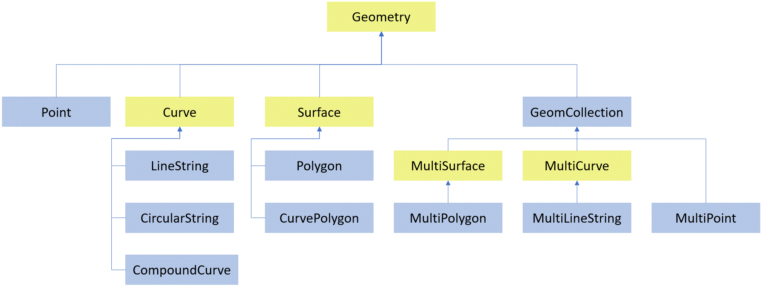
SQL Server Spatial & JSON Data
Spatial data represents information about the physical location and shape of geometric objects. These objects can be point locations or more complex objects such as countries/regions, roads, or lakes.
SQL Server supports two spatial data types: the geometry data type and the geography data type.
The geometry type represents data in a Euclidean (flat) coordinate system.
The geography type represents data in a round-earth coordinate system.

Slide 12
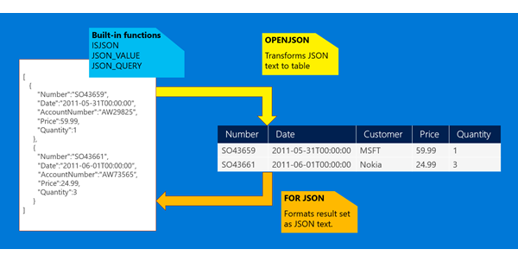
SQL Server JSON Data
JSON is a popular textual data format that's used for exchanging data in modern web and mobile applications. JSON is also used for storing unstructured data in log files or NoSQL databases such as Microsoft Azure Cosmos DB.
JSON Data types are supported in Azure SQL Database, Azure SQL Managed Instance, SQL Server 2025.

Slide 13

JSON Data in SQL Server Use Cases
Simplify complex data models
Consider denormalizing your data model with JSON fields in place of multiple child tables.
Store retail and e-commerce data
Store info about products with a wide range of variable attributes in a denormalized model for flexibility.
Process log and telemetry data
Load, query, and analyze log data stored as JSON files with all the power of the Transact-SQL language.
Store semi-structured IoT data
When you need real-time analysis of IoT data, load the incoming data directly into the database instead of staging it in a storage location.
Simplify REST API development
Transform relational data from your database easily into the JSON format used by the REST APIs that support your web site.

Slide 14
Vector Search & Indexes in SQL Server
Vectors are ordered arrays of numbers (typically floats) that can represent information about some data. For example, an image can be represented as a vector of pixel values, or a string of text can be represented as a vector of ASCII values.
The process to turn data into a vector is called vectorization. The vector data type in SQL Server is designed to store these arrays of numbers efficiently.
Vector search refers to the process of finding all vectors in a dataset that are similar
SQL Server provides built-in support for vectors via the vector data type. Vectors are stored in an optimized binary format but exposed as JSON arrays for convenience. Each element of the vector is stored using single-precision (4 bytes) floating-point value.
Along with the data type there are dedicated functions to operate on vectors. to a specific query vector. Therefore, a query vector for the word human searches the entire dataset for similar vectors, and thus similar words.
SELECT
CAST('[1.0, -0.2, 30]' AS VECTOR(3)) AS v1,
CAST(JSON_ARRAY(1.0, -0.2, 30) AS VECTOR(3)) AS v2;

Slide 15
XML Data & Key Value Pair Data
SQL Server provides a powerful platform for developing rich applications for semi-structured data management. Support for XML is integrated into all the components in SQL Server in the following ways:
The xml data type. XML values can be stored natively in an xml data type column that can be typed according to a collection of XML schemas, or left untyped. You can index the XML column.
The ability to specify an XQuery query against XML data stored in columns and variables of the xml type.
Enhancements to OPENROWSET to allow bulk loading of XML data.
The FOR XML clause, to retrieve relational data in XML format.
The OPENXML function, to retrieve XML data in relational format.
XML compression provides a method to compress off-row XML data for both XML columns and indexes, improving capacity requirements
Azure SQL also provides multi-model capabilities, including support for JSON, XML, and Graph data. Regardless of data model, developers can continue using familiar SQL language.

Slide 16
SQL Server Database Engine
The Database Engine is the core service for storing, processing, and securing data. The Database Engine provides controlled access and transaction processing to meet the requirements of the most demanding data consuming applications within your enterprise. The Database Engine also provides rich support for sustaining business continuity through Business continuity and database recovery.
You can use Always On availability groups, failover cluster instances, and log shipping in different ways, and not just for availability. There are four main ways you can use the availability features:
High availability
Disaster recovery
Migrations and upgrades
Scaling out readable copies of one or more databases

Slide 17

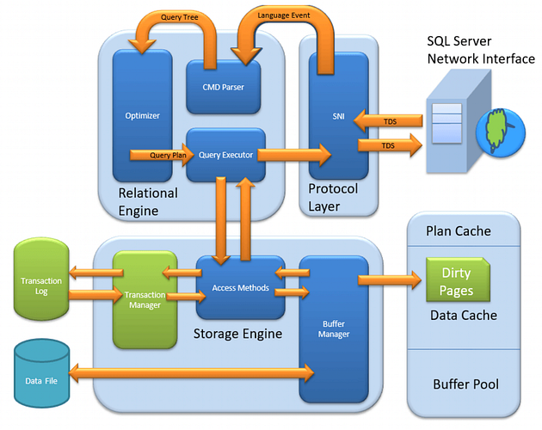
SQL Server Platform Architecture
SQL Server operates using a client-server architecture, where the database engine handles data management and user requests, while clients interact with the server to execute queries and retrieve data.

Slide 18
Database Design with SQL Server
Hierarchical data is defined as a set of data items that are related to each other by hierarchical relationships. Hierarchical relationships exist where one item of data is the parent of another item. Examples of the hierarchical data that is commonly stored in databases include the following items:
An organizational structure
A file system
A set of tasks in a project
A taxonomy of language terms
A graph of links between Web pages
Collations in the SQL Server Database Engine provide sorting rules, case, and accent sensitivity properties for your data. Collations that are used with character data types, such as char and varchar, dictate the code page and corresponding characters that can be represented for that data type.
A collation specifies the bit patterns that represent each character in a dataset. Collations also determine the rules that sort and compare data. SQL Server supports storing objects that have different collations in a single database

Slide 19
SQL Server Database Overview
A database in SQL Server is made up of a collection of tables that stores a specific set of structured data. A table contains a collection of rows, also referred to as records or tuples, and columns, also referred to as attributes. Each column in the table is designed to store a certain type of information, for example, dates, names, dollar amounts, and numbers.
SQL Server databases are stored in the file system in files. Files can be grouped into filegroups.
SQL Server Management Studio (SSMS) is an integrated environment for managing any SQL infrastructure. Use SSMS to access, configure, manage, administer, and develop platforms.
SSMS brings together graphical tools and rich editors to help you:
Connect securely to SQL Server, Azure SQL, and related services. Manage objects by using Object Explorer and design tools.
Query, script, and tune workloads by using the Query Editor, execution plans, and built-in performance tools.
Administer business intelligence features such as Integration Services (SSIS), Analysis Services (SSAS), and Reporting Services (SSRS).

Slide 20
SQL Server Index Types
Hash
Index with computed columns
Spatial
Memory-optimized Non-clustered
Clustered
Non-clustered Index
Unique
Columnstore
Index with Included columns
XML
Full-text

Slide 21
SQL Server Tables
Tables are database objects that contain all the data in a database. In tables, data is logically organized in a row-and-column format similar to a spreadsheet. Each row represents a unique record, and each column represents a field in the record.
Partitioned tables are tables whose data is horizontally divided into units which might be spread across more than one filegroup in a database.
Partitioning makes large tables or indexes more manageable by letting you access or manage subsets of data quickly and efficiently, while maintaining the integrity of the overall collection. By default, SQL Server supports up to 15,000 partitions.
Temporary tables are stored in tempdb. There are two types of temporary tables: local and global.
Local temporary tables, also known as session-scoped temporary tables, have a single number sign (#) as the first character of their names; they are visible only to the current connection for the user, and they are deleted when the user disconnects from the instance of SQL Server.
Global temporary tables have two number signs (##) as the first characters of their names; they are visible to any user after they are created, and they are deleted when all users referencing the table disconnect from the instance of SQL Server.

Slide 22
SQL Server Configuration Manager
SQL Server Configuration Manager is a tool to manage the services associated with SQL Server, configure the network protocols used by SQL Server, and manage the network connectivity configuration from SQL Server client computers. In SQL Server 2022 (16.x) and later versions, you can also use SQL Server Configuration Manager to manage the Azure extension for SQL Server.
SQL Server supports Shared Memory, TCP/IP, and Named Pipes protocols. For information about choosing network protocols, see Configure client protocols. SQL Server doesn't support VIA, Banyan VINES Sequenced Packet Protocol (SPP), Multiprotocol, AppleTalk, or NWLink IPX/SPX network protocols.
Clients previously connecting with these protocols must select a different protocol to connect to SQL Server. You can't use SQL Server Configuration Manager to configure the WinSock proxy. To configure the WinSock proxy, see your Internet Security and Authentication Server (ISA) documentation.

Slide 23

Overview of Azure SQL
Azure SQL Database is always running on the latest stable version of the SQL Server database engine and patched OS with enterprise class availability SLA which is higher when zone redundancy is implemented. PaaS capabilities built into Azure SQL Database enable you to focus on the domain-specific database administration and optimization activities that are critical for your business.
1
Azure SQL Database is based on the latest stable version of the Microsoft SQL Server database engine. You can use advanced query processing features, such as high-performance in-memory technologies and intelligent query processing. In fact, the newest capabilities of SQL Server are released first to Azure SQL Database, and then to SQL Server itself.
2
SQL Database enables you to easily define and scale performance within two different purchasing models: a vCore-based purchasing model and a DTU-based purchasing model. SQL Database is a fully managed service that has built-in high availability, backups, and other common maintenance operations. Microsoft handles all patching and updating of the SQL and operating system code.
3

Slide 24
Difference Between SQL Server & Azure SQL
Feature | SQL Server | Azure SQL
Hosting | On-premises hardware or Virtual Machines (VMs). | Cloud native service on Azure SQL
Management | Manual patching, backups & OS maintenance | Fully managed, automatic patched, backups, tuning
Scalability | Limited by physical server, hardware, requires manual upgrade | Dynamic scaling, automated scaling of compute and storage resources with minimal downtime
Cost Optimization | Typically involves upfront licensing cost (standard, Enterprise) plus hardware expenses | Uses pay-as-you-go model for DTU or vCore based SQL engine based on variable workloads
Feature | Supports 100% SQL Server features, including SQL Server Agent, Linked servers and cross-database queries. | SQL Server Agent & Linked servers aren't supported. Elastic Jobs are supported.

Slide 25
Wrap Up
SQL Server Data Types & Compatibility
SQL Server Platform Architecture
SQL Server Installation Tools
SQL Server & Azure SQL Comparison

